Slide 1
Python Fundamentals
A summary of python structures and building blocks

Slide 2
Contents
Data Structures
Variables (int, string, float etc.)
Lists (multiple items, multiple dimensions)
Dictionaries (key-value pairs)
Data Operators:
Conditionals (if/else, try/except)
Loops (for, while)
Functions (arguments, return values)

Slide 3
Types of Things in Python
In general most python ‘things’ can be categorised as either a data Structure or a
data Operator. These are the building blocks of all python code.
Data Structure (for storing data)
Data Operator (for acting on data)
Variables:
Conditionals
Loops
Functions
Lists/arrays
Dictionaries
Note: Python libraries, imports etc. are all built on or replace the basic python
code structures – numpy arrays replace lists, matplotlib adds new functions

Slide 4
Types of Things in Python
In general most python ‘things’ can be categorised as either a data Structure or a
data Operator
Data Structure (for storing data)
Data Operator (for acting on data)
Variables:
Int (numbers)
String
Float (decimals)
Boolean (true/false)
Conditionals – if/else
Loops – for/while
Functions – def my_function
Lists/arrays – same thing in python
(set of multiple variables
stored together)
Dictionaries – Set of items grouped by
key - value

Slide 5
Data Structures

Slide 6
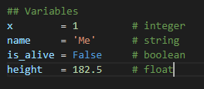
Variables
Storing single elements of data in python

Slide 7
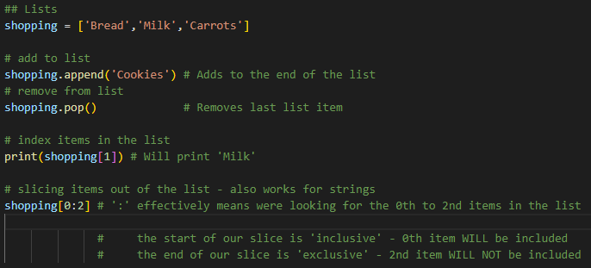
Lists
Storing multiple elements grouped together
Note: Python lists index from the 0th item, so ‘Bread’ is item 0, ‘Milk’ is item 1, etc.

Slide 8
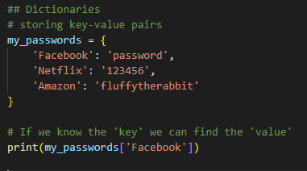
Dictionaries
Storing multiple elements grouped as key and value pairs

Slide 9
Data Operators

Slide 10
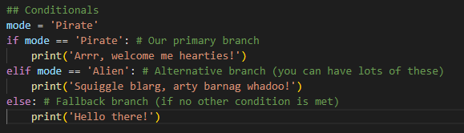
Conditionals
Branching code if we want to do different things with different results
With if/else statements, we can do one thing if some condition is true, and something else if it isn’t.
Note: A single equals ‘=‘ represents variable assignment – you tell the computer you want mode to be equal to ‘Pirate’.
A double equals ‘==‘ represents a question – you are asking ‘is mode equal to Pirate?’ You would get an error message if you tried to put ‘if mode = Pirate’

Slide 11
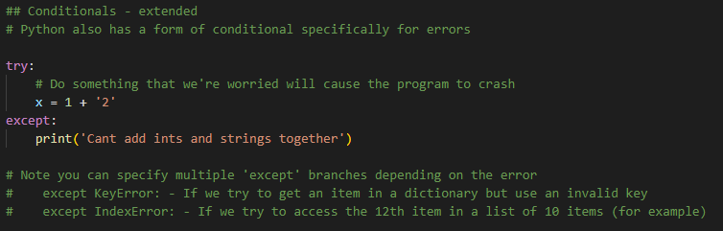
Conditionals - extended
Branching code if we want to do different things with different results.
Python has error checking conditionals that can be used to handle errors that arise when we run the program so it doesn’t just crash

Slide 12
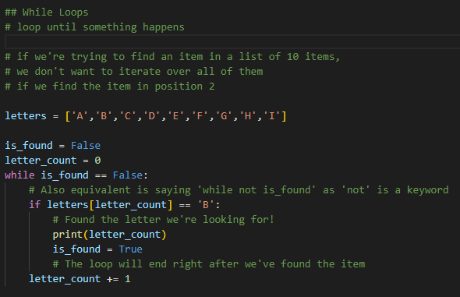
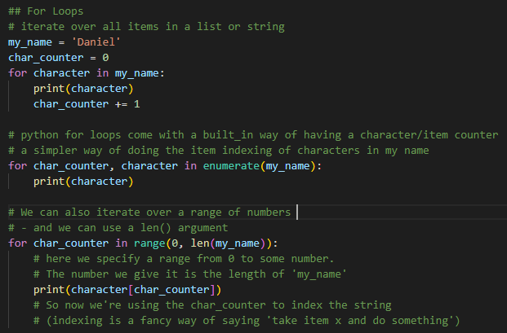
Loops
Acting on lots of data repeatedly
For Loops:
Do something a specific number of times:
- iterate over all items in a list (fixed size)
- iterate through a range of items (fixed range)
While Loops:
Do something until a condition has been met:
- loop until I find some item in a list

Slide 13
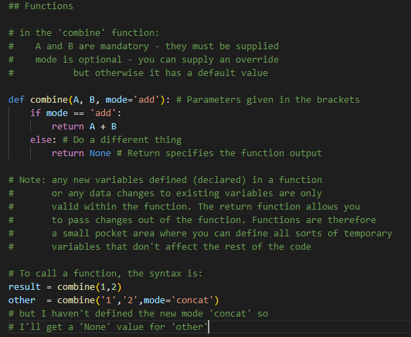
Functions
Storing a set of code we want to repeat – a function usually has a specific task to accomplish.
Functions have parameter inputs, return outputs and generally accomplish something by manipulating the data you pass them.
Function parameters can be Mandatory or Optional
Note: Return is also optional (other languages are different)

Slide 14
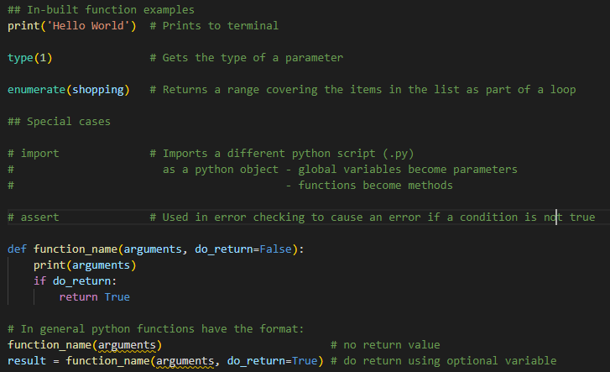
In-built functions
Some examples of the in-built functions python includes. There are many more detailed in the python docs

